Slide 1
Arrays
Lecture # 10

Slide 2

Arrays
Array is a collection of variables of the same data type placed closely in memory.
The array stores a fixed-size sequential collection of elements of the same type
The items or elements of array are accessed by index number.
Arrays can be used to store basic data types, i.e. int, char and float etc.
Notes:
Arrays are used to store multiple values in a single variable.
COLLECTION OF ELEMENTS WHICH ARE SAME.
An array is a collection of similar items stored in contiguous (having no gap between them)memory locations
In general we can say that array will always have Elements which are of same type. Like group or collection of students,
Or group of patients etc.
If there is a collection in which different elemets are present like if group of integer and floating point elements are present then it will not be an array.

Slide 3
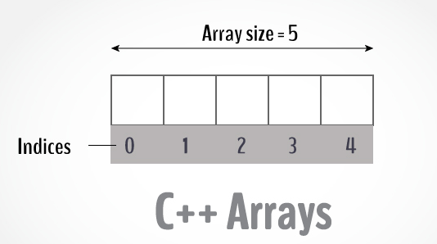
Array size=total number of elements present in an array index= location of particular element in an array
Notes:
Here you can see there is a tightly packed sequence of cells. We can say it an array.
So any array will have size which means total number of elements
And indices which means location of particular element

Slide 4
Declaring Array
type arrayName [ arraysize ];
int balance[5];
[] brackets are the clear indication of an array

Slide 5
Initializing Array
int balance[5]={10,20,30,40,50}; means datatype arrayname [size]={ n elements}
10 | 20 | 30 | 40 | 50
Balance =
All the data present in an array is of integer datatype
Notes:
10,20,30,40,50 are the elements in an array

Slide 6
Accessing Array Elements
Array elements start from location 0.
This location is also known as index.
Any element can be accessed by writing index inside [] brackets. i.e.
arrayName [index];
balance [0];
Notes:
As you can see that index will be written inside square brackets and it will access the location of particular array element.

Slide 7
Accessing Array Elements
int balance[5]={10,20,30,40,50};
balance [0] means 10
balance [1] means 20
balance [2] means 30
balance [3] means 40
balance [4] means 50
Note: array elements are n but array index will start from 0 to n-1
Array elements here are 5 but array index will start from 0 to 5-1 means 4
10 | 20 | 30 | 40 | 50
Balance =

Slide 8
Accessing Array Elements
int balance[5]={10,20,30,40,50};
10 | 20 | 30 | 40 | 50
Balance =
balance[0] | balance[1] | balance[2] | balance[3] | balance[4]
Notes:
You can access the array element by writing arrayname [ index ]( array name index ) of the particular location

Slide 9
Another Example

Slide 10
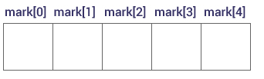
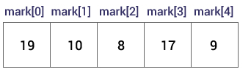
How to declare an array in C++?
dataType arrayName[arraySize];
float mark[5];
Elements of an Array and How to access them?
How to initialize an array
int mark[5] = {19, 10, 8, 17, 9};
Another method int mark[] = {19, 10, 8, 17, 9}
Notes:
Here is another example in which we can see that how we can declare an array and how to access any array element and after that how you can initialize an array. Initialization means assigning values to an array. There are two methods by which we can assign any value to an array.
1 is if we mention size of an array along with elements at the time of declaration
2 is if we write empty square brackets and assign values to the array that will indicate the total number of elements present in an array.

Slide 11
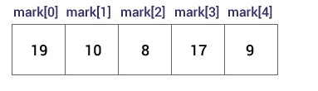
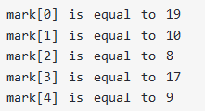
Example to initialize an array
int mark[] = {19, 10, 8, 17, 9};

Slide 12
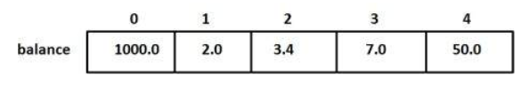
Another Example of way to initialize an array
double balance[5] = {1000.0, 2.0, 3.4, 17.0, 50.0};
double balance[] = {1000.0, 2.0, 3.4, 17.0, 50.0};

Slide 13
How to insert and print array elements?
int mark[5] = {19, 10, 8, 17, 9}
// change 4th element to 19 means 17 to 19
mark[3] = 19;
// take input from the user and insert in third element
cin >> mark[2];
// take input from the user and insert in (i+1)th element
cin >> mark[i];
// print first element of the array
cout << mark[0];
// print ith element of the array
cout >> mark[i-1];

Slide 14
Display the array elements.
#include <iostream>
using namespace std;
int main(){
int arr[] = {11, 22, 33, 44, 55};
//use index of elements
cout<<arr[0]<<endl;
cout<<arr[1]<<endl;
cout<<arr[2]<<endl;
cout<<arr[3]<<endl;
cout<<arr[4]<<endl;
}
output
11
22
33
44
55

Slide 15
C++ program to store entered by the user using arrays. (this Program will only take input)
#include <iostream>
using namespace std;
int main()
{
int numbers[5];
cout << "Enter 5 numbers: ";
for (int i = 0; i < 5; ++i)
{
cin >> numbers[i];
}
}

Slide 16
C++ program to store numbers entered by the user using arrays and display them.
#include <iostream>
using namespace std;
int main()
{
int numbers[5];
cout << "Enter 5 numbers: ";
for (int i = 0; i < 5; i++) // this loop will take input
{
cin >> numbers[i];
}
cout<<"Entered Numbers are";
for (int i = 0; i < 5; i++) // this loop will display output
{
cout<< numbers[i]<<"\n";
}
}

Slide 17
C++ program to store and calculate the sum of 5 numbers entered by the user using arrays.
#include <iostream>
using namespace std;
int main()
{
int numbers[5], sum = 0;
cout << "Enter 5 numbers: ";
// Storing 5 number entered by user in an array
// Finding the sum of numbers entered
for (int i = 0; i < 5; ++i)
{
cin >> numbers[i];
sum += numbers[i];
}
cout << "Sum = " << sum << endl;
return 0;
}

Slide 18
Accessing Array elements using Loop
#include <iostream>
using namespace std;
int main(){
int arr[] = {11, 22, 33, 44, 55};
int n=0;
while(n<=4)
{
cout<<arr[n]<<endl;
n++;
}
}

Slide 19
// arrays example
#include <iostream>
using namespace std;
int foo [] = {16, 2, 77, 40, 12071};
int n, result=0;
int main ()
{
for ( n=0 ; n<5 ; ++n )
{
result += foo[n];
}
cout << result; return 0;
}

